Slide 1

B18 Lesson 3
Bishop Stopford School
faith | justice | responsibility | truth | compassion
ONLINE LEARNING
Learning Objectives
Retrieval
Acquire
Action
Review
Dig Deeper

Slide 2
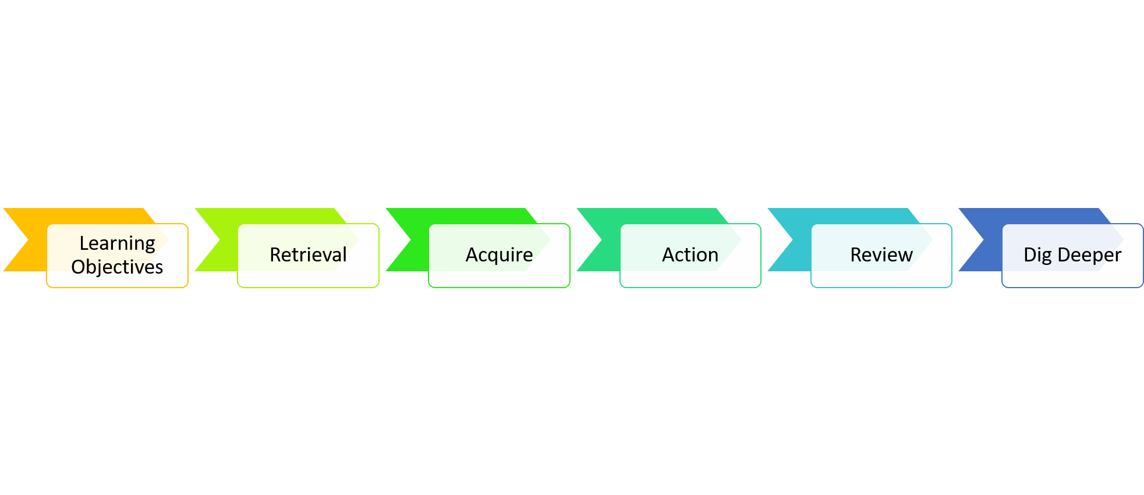
Global Warming
Learning Objectives
1)Describe the greenhouse effect
2)Explain problems associated with global warming

Slide 3
Starter
From memory state as many reasons as you can for why deforestation is happening.
Go back to your list from last lesson. Tick off those you got with green, add any you missed off

Slide 4


Watch Video 1
You can watch this video as many times as you want to

Slide 5
Watch Video 2

Slide 6
Key Notes
Levels of carbon dioxide and methane (greenhouse gases) in the atmosphere are increasing. This contributes to ‘global warming’
The consequences of global warming are:
melting of the polar ice caps
the rise in sea level may one day threaten many cities such as London, New York and Amsterdam
weather patterns will change with more unusual weather
tropical diseases may become more common in other regions, such as the Europe
many species will become extinct

Slide 7
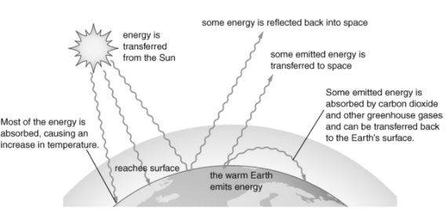
Key Diagram – The greenhouse effect

Slide 8
Task
Complete the Global warming Evidence worksheet on the firefly page.
https://bishopstopford.fireflycloud.net/science-2/school-closure-tasks/year-10-1/biology/triple/b18-biodiveristy-and-ecosystems
Remember you can either print off the worksheet OR just write the answers in full sentences in your book

Slide 9

Review
Once you have completed the sheet self-assess it using the answer sheet.
https://bishopstopford.fireflycloud.net/science-2/school-closure-tasks/year-10-1/biology/triple/b18-biodiveristy-and-ecosystems
Make corrections, add a score, give yourself a WWW/EBI

Slide 10
Dig deeper (optional)
On June 1, 2017, United States President Donald Trump announced that the U.S. would cease all participation in the 2015 Paris Agreement.
Research what the Paris Agreement is and why it is so important.
Write a newspaper page that could have been published in June 2017, reporting on the news that the U.S had pulled out of the agreement.

